Slide 1
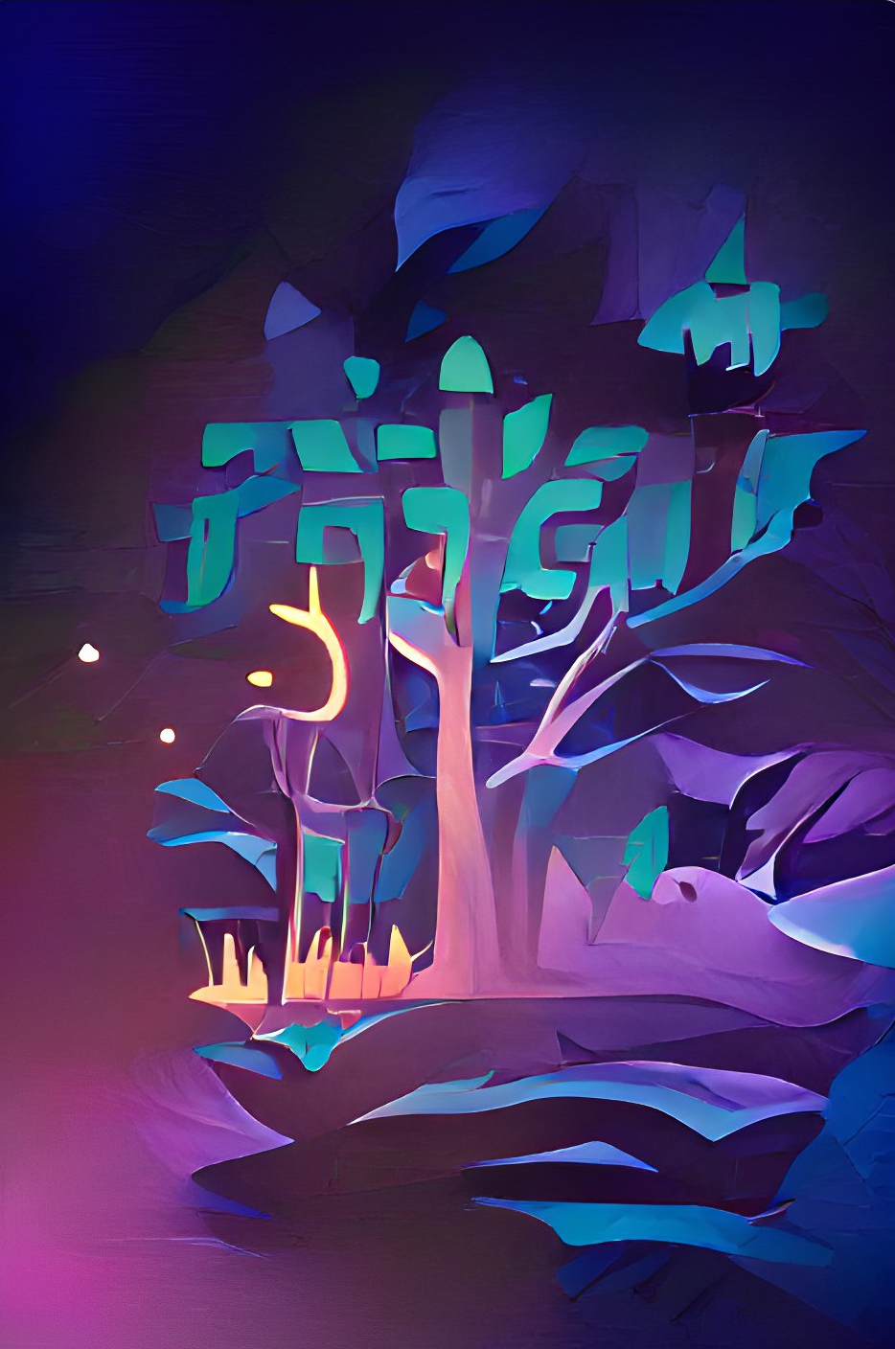
“A mere maiden”: Describing Lúthien Tinúviel’s relationship with dance and song across 5 manuscripts through tf-idf scores and fuzzy matching
1/10
Notes:
“A mere maiden”: describing Luthien Tinuviel’s relationship with dance and song through tf-idf scores and fuzzy matching.
For this presentation, I chose to set up a proposal for my final research paper. Today, I will outline the context of the research, describe one previous researcher’s work, explain why I think tf-idf scores and fuzzy matching are suitable for this hypothesis, and then describe what I hope the outcomes will look like. Because this is a proposal, I would like to hear your feedback on how I can improve any aspect of my research paper at the end of this presentation.

Slide 2
Overview:
Who is Lúthien Tinúviel?
Clare Moore’s interpretation of Lúthien Tinúviel
Making Moore’s hypothesis testable with
tf-idf scores
fuzzy matching (n-gram search)
Anticipated findings
2/10
Notes:
Here’s what we will cover
Who is Lúthien Tinúviel and what have scholars said about her
Why I have chosen to bounce my research specifically on Clare Moore’s interpretation of Luthien Tinuviel
How I will make Moore’s hypothesis testable with computational methods
What I anticipate I will find with the fuzzy match, tf-idf score, and what that means for Moore’s hypothesis, and how we can interpret those computational results in a way that makes sense with literary studies, not just statistics

Slide 3
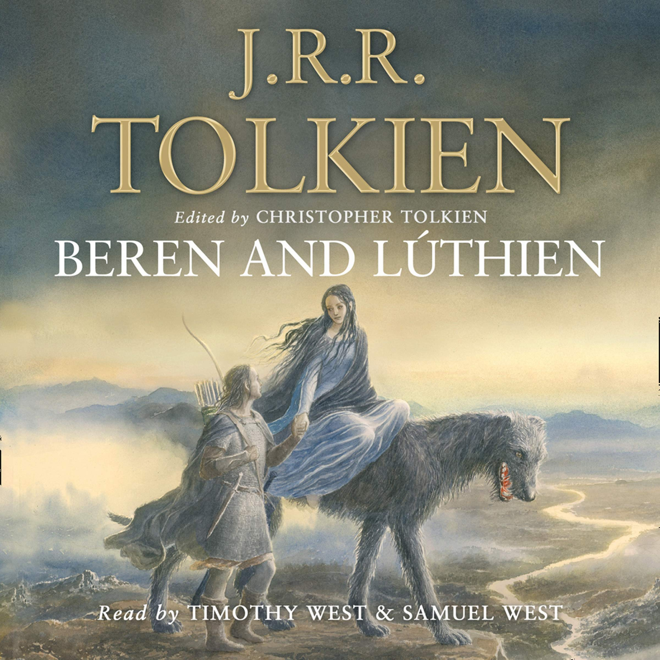
1. Lúthien Tinúviel
Fictional character in J.R.R. Tolkien’s Middle-Earth
Power comes from her femininity (debatable), especially dance and song
The story of Lúthien was written in so many manuscripts that the way her character is described changes a lot – sometimes her power is just from dance, sometimes it’s just from song
Also complicated because Christopher Tolkien edited his father’s manuscripts, changing how Lúthien is described
3/10

Slide 4
1. Lúthien Tinúviel
The tale of Tinúviel (1917)
The Lay of Leithian (1925)
Sketch of the mythology (1926)
Quenta Noldorinwa (1930)
Quenta Silmarillion (published 1977, ed. by C. Tolkien)
4/10
Notes:
Just for clarity’s sake, those 5 textual versions of the story of Luthien are:
The tale of Tinuviel
The Lay of Leithian
Sketch of the mythology
Quenta Noldorinwa
Quenta Silmarillion
And these 5 texts will make up the corpus that we study in R.

Slide 5
2. Clare Moore’s interpretation of LT
Methodology: compared 5 texts which all tell different versions of the Lúthien story. Focuses on the sources of Lúthien’s power, i.e. song and dance. Used close reading (no computation, only quoted passages).
Outcomes: found that earlier drafts showed Lúthien as less autonomous, less powerful. Subsequent revisions and drafts showed the evolution of the character into a powerful, active, and independent character who is central to the legendarium.
5/10

Slide 6
3. Making Moore’s hypothesis testable
Moore’s hypothesis | Test plan
“J.R.R. Tolkien’s shift from dance [as the main source of her power] to song in this scene reveals a focal shift […] Vink […] noted that the ratio between song-related words shifts dramatically between versions, with a 4:1 song:dance ratio in the Lay compared to a 16:1 ratio in chapter nineteen of The Silmarillion.” | Term frequency of “danc*” (which includes “dancing,” “dances,” “danced,” etc.) Term frequency of “sing*” and “song*” (which includes “singing”, “songs”) Potential error: “singed” (not “sang”, because Tolkien used antiquated spellings) also meaning burnt. Run on all 5 different texts. Using tf along with idf, i.e. tf-idf Problems with tf-idf: frequency isn’t always the best measure of how important a word is in a text, especially fiction
6/10
Notes:
So we’ll take Moore’s hypothesis, break it down into two chunks, and make each chunk machine testable. I’m going to use two tests, and each slide now will cover one test.
When I say ‘testable,’ I don’t mean to imply that she hasn’t already tested it. She did, using close reading (you know, just normal reading the text and pulling out quotations and writing an English essay-style report). I say ‘testing’ as in using NLP testing, using the concepts form chs 3 and 4 of the Tidy Text Mining textbook.
She quotes Vink, who has already counted the ration between song:dance, but only for two texts. We don’t see any overall study of song and dance across all 5 texts, so that’s what I will do.
Not only will I calculate the term frequency for singing and dancing, I will also create a token distribution plot across the text so we can see exactly when it’s occurring. That will be useful for studying the relationship between the word occurrences and the plot of the story. For example, does “singing” tend to occur when there is a physical threat to Luthien herself, or does “singing” tend to occur when there is a threat to her lover, Beren? What can this tell us about how selfless she is? [Read right-hand-side where eyou explain what a wildcard search you will use]
Then I’ll graph the differences between the five texts so we can see what the spread is like across the corpus.
I will also calculate the tf-idf in addition to the tf, but I have to be careful when interpreting this since frequency isn’t always the best measure of how important a word is in a text.

Slide 7
3. Making Moore’s hypothesis testable
Moore’s hypothesis | Test plan
“The oscillation of who names Luthien – herself or Morgoth – reveals that J.R.R. Tolkien’s development of Luthien’s agency is not always a steady progression.” I wonder if there are other direct passages of text that we can quote that show nearly exact same phrasing of words. That can help us find the “essential differences” between drafts’ portrayal of the character, aside from song and dance alone. | Fuzzy matching using n-grams and regex, using several key scenes (climaxes) that occur repeatedly throughout the 5 texts, to identify what words changed: Beren’s first encounter with Lúthien Lúthien putting guards to sleep with song Lúthien’s battle against the monster Morgoth The naming of Lúthien (herself or Morgoth) Method here is similar to those described in Shmidman et al.’s paper identifying similar parallel passages across various versions of the Talmud [2].
7/10
Notes:
The second part of Moore’s hypothesis includes finding parallel passages between the 5 texts. She quotes another researcher, Vink, who did this manually and they didn’t identify them very explicitly. I want to use n-grams and regex to search for phrases in those texts that are almost exactly the same, especially within these four specific plot points: Beren’s first encounter with Luthien, Luthien putting guards to sleep with song, Luthien’s battle against the monster Morgoth, and the naming of Luthien.
Some other researchers have used a similar method, called “fuzzy matching,” on the various versions of the Jewish Talmud, so I know this works, and it works much more quickly than the human eye/brain could.

Slide 8
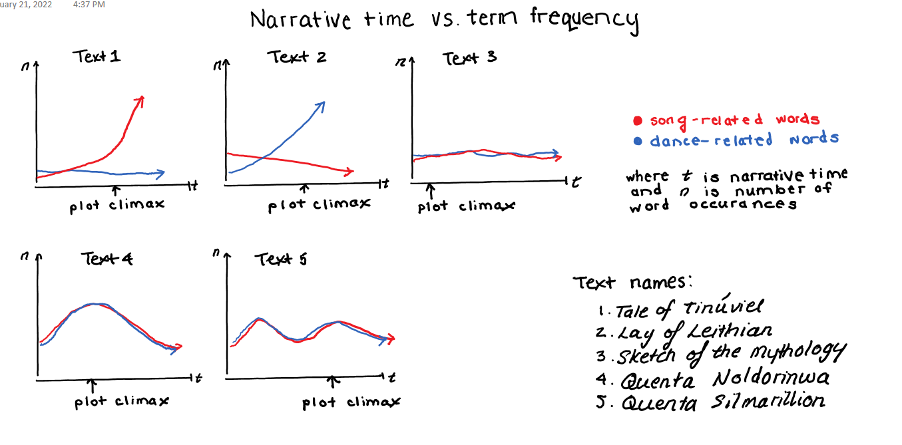
4. Anticipated findings
8/10
Notes:
Here is what I think the findings will look like for token counts. [Give them 5 seconds to look in silence] The graphs' inflection points certainly won’t be exactly in the same locations, but for now it’s a good place to start thinking about how to interpret the results.
This first diagram shows the token-distribution plot, i.e. just marking out how much “song” and “dance” occurs in relation to time progressing. Each of the five texts in the corpus will have their own graph, and we’ll mark out dance in blue, song in red. I will also mark out on the time axis where the climax of the plot it so we can focus on that spot especially. This climax marking is objective and will help us understand where the critical points are when Luthien is using her powers. By the way, the graphs will probably start out looking more like a bar graph, with one bar per chapter or per 100 words, but then I’ll smooth it out with Loess smoothing to get this line graph here.
So let’s try to analyse what theoretical data we have here just to get a feel of how it’ll work. In Text 1, we can see that dance-related words remain fairly consistent, and low, throughout the story. Even the climax doesn’t include an increase in words about Luthien’s dance. However, the use of song-related words increases significantly over the course of the story. And vice versa, we can do this mini-analysis for the other 4 graphs too.
What is most interesting is when we compare graphs to each other. Text 3 compared to text 1 is a great example. Since text 3 was written after text 1, we can make an observation about how Tolkien changed Luthien’s use of dance-and-song. Dance and song appear at about the same frequency as each other throughout the book (i.e. the two lines are close together over time), and the number of times they appear stays at a consistent n through the chapters. So from text 1 to text 3, Tolkien has created more autonomy in Luthien’s powers by giving her more ability to act through dance and song. Plus, compared to text 1, text 3 does not focus especially on song only, but also her physical influence through dance.
Also, we can see in graphs 4 and 5 that Luthien tends to use her song-and-dance powers more often during the plot climaxes in these texts, but not necessarily in the first 3 texts.

Slide 9
4. Anticipated findings
E.g. 1 taken from Beren’s first encounter of Lúthien
E.g. 2 taken from Lúthien’s conversation with Daeron
 | Quenta Silmarillion, prose | Lay of Leithian, poetry
1 | in the grass unfading still | unfading grass in the glades
2 | 'Death is the guerdon thou hast earned, O base born mortal, who hast learned in Morgoth's realm to spy and lurk like Orcs that do his evil work!' | of which I repent, baseborn mortal, who in the realm of Morgoth has learnt to creep in secret as his spies and thralls
9/10
Notes:
Here’s what I think the results from the second test will look like.
Here’s two examples from two texts of the corpus.
#1. We can see that the words “unfading” and “grass” have occurred together in both these instances. Word choice is extremely important to Tolkien, so I will use ngrams to check which similar descriptions he used in between the 5 texts. I think it will start with small ngrams, like bigrams, just to capture as much as possible, but then I will adjust to larger 4-grams, and 5-grams. Plus, I will allow for one word to be “off.” E.g. “in the grass unfading still” is one word off from “unfading grass in the glades,” since glades and still are the unique words.
Using this method, we can try to estimate a similarity index for the texts when compared to each other and further highlight any changes to the plot overall. Of course that includes the changes to the Luthien character, but it also could lead to future research on changes to plot points unrelated to Luthien, including plot points about her family (the elves) or Beren and his family (the humans), who take up a significant part of the book.
#2. Example two is a good example again of similar phrases. We see “base born mortal” in both quotations. But here’s a tricky part. I’ll have to be careful when designing the search function to include base space born, and baseborn (one word), because the different stories use different versions of the same word. Tolkien made these choices very conscientiously too, since he was a linguist, so I’ll need to consider that when writing my final analysis. We can also see that he used archaic spellings of the same words too, like hast/has, learned/learnt.

Slide 10
Sources
[1] Moore, Clare. “A song of greater power: Tolkien’s construction of Lúthien Tinúviel." Mallorn: The Journal of the Tolkien Society, Winter, 62, 2021, 6-16.
[2] Shmidman, Avi et al. “Identification of Parallel Passages Across a Large Hebrew/Aramaic Corpus.” Journal of Data Mining & Digital Humanities, 2018.
[3] Vink, Renee, and Friedhelm Schneidewind. “Dance and Song: 'The Lay of Leithian' between 'The Tale of Tinúviel' and 'Of Beren and Lúthien.’” Music in Tolkien's Work and Beyond, Walking Tree Publishers, 2019.
10/10
Notes:
For now the sources are in MLA.

